Slide 1
Deep Neural Networks
From CS188, FA18, UC Berkeley: http://ai.berkeley.edu.

Slide 2
Deep Learning
Multi-layer artificial neural networks

Slide 3

Rise of DL
Data
Compute
Algorithms

Slide 4
Deep learning
What is its position wrt to ML and AI?

Slide 5
Key differences with other ML techniques
It learns the features itself
It is scalable and learn from any large data

Slide 6
Applications
Natural language processing
Machine translation
Search
Sentiment analysis
Large language models
Computer vision
Image captioning
Image generation
Image classification
Image segmentation
Recommendation systems

Slide 7
How well does it work?

Slide 8

Computer Vision
Notes:
8

Slide 9
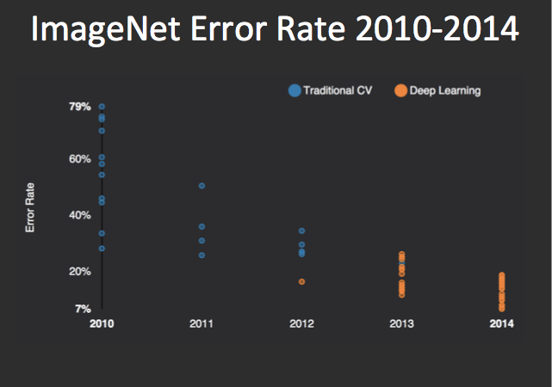
Performance
AlexNet
graph credit Matt Zeiler, Clarifai

Slide 10
Performance
AlexNet
graph credit Matt Zeiler, Clarifai

Slide 11
Performance
AlexNet
graph credit Matt Zeiler, Clarifai

Slide 12
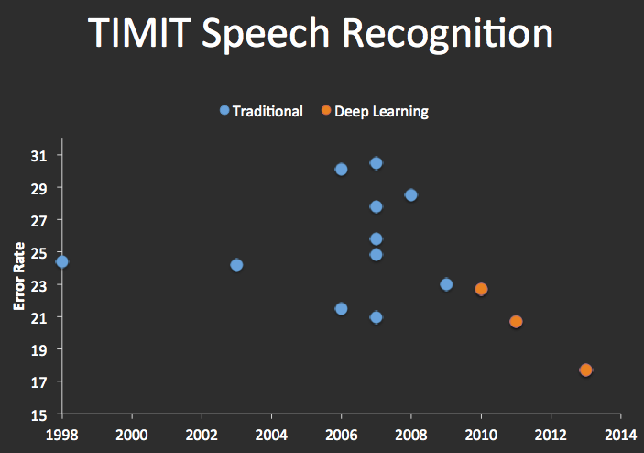


Speech Recognition
graph credit Matt Zeiler, Clarifai

Slide 13
Natural language processing
BERT (2017)
ChatGPT (2022)

Slide 14
But what is ANN?

Slide 15
Multi-class Logistic Regression
= special case of neural network
f₁(x)
z₁
softmax
f₂(x)
z₂
f₃(x)
…
z₃
f_{K}(x)

Slide 16
Deep Neural Network = Also learn the features!
f₁(x)
z₁
softmax
f₂(x)
z₂
f₃(x)
…
z₃
f_{K}(x)

Slide 17
Deep Neural Network = Also learn the features!
x₁
f₁(x)
softmax
x₂
f₂(x)
…
x₃
f₃(x)
…
…
…
…
…
x_{L}
f_{K}(x)
g = nonlinear activation function

Slide 18
Deep Neural Network = Also learn the features!
x₁
softmax
x₂
…
x₃
…
…
…
…
…
x_{L}
g = nonlinear activation function

Slide 19
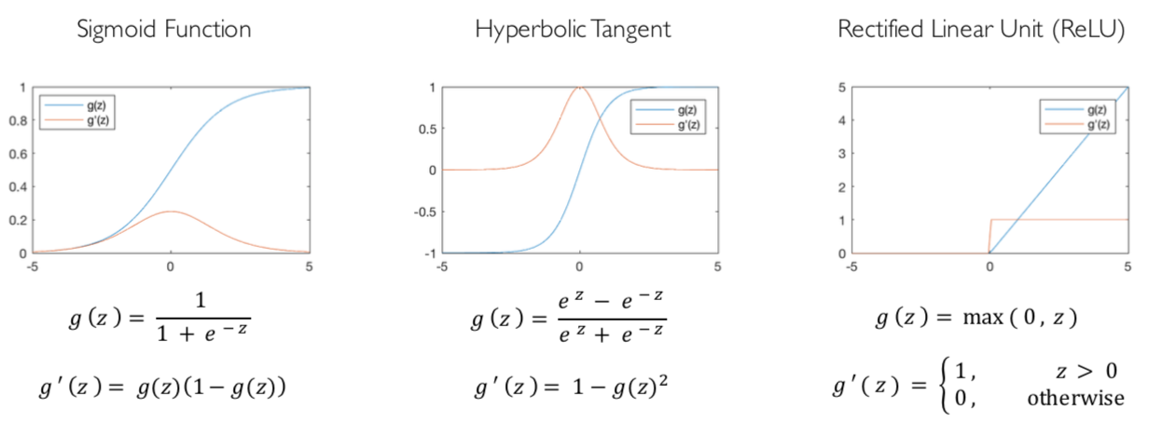
Common Activation Functions
[source: MIT 6.S191 introtodeeplearning.com]

Slide 20
Deep Neural Network: Also Learn the Features!
Training the deep neural network is just like logistic regression:
just w tends to be a much, much larger vector ☺
just run gradient ascent
+ stop when log likelihood of hold-out data starts to decrease

Slide 21

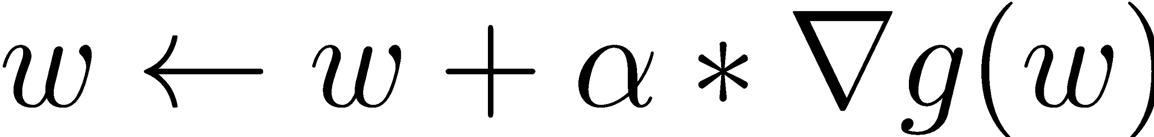

Optimization Procedure: Gradient Ascent
init
for iter = 1, 2, …
: learning rate --- tweaking parameter that needs to be chosen carefully
How? Try multiple choices
Crude rule of thumb: update changes about 0.1 – 1 %

Slide 22
Minimizing loss functions
In practice we minimize the loss instead of maximizing the objective function
E.g.,
Cross-entropy loss for classification
Mean squared error for regression

Slide 23
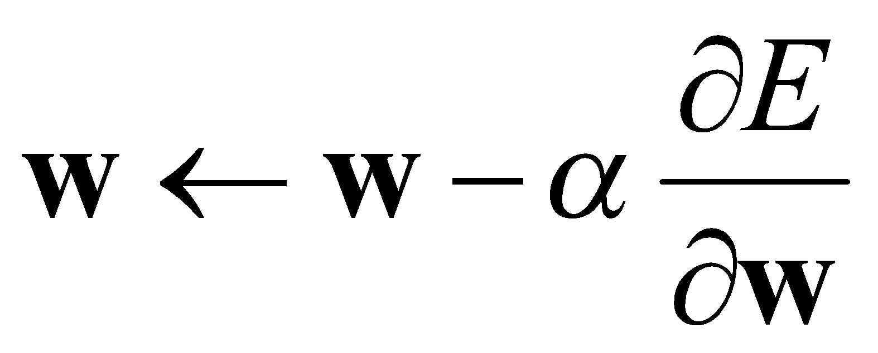
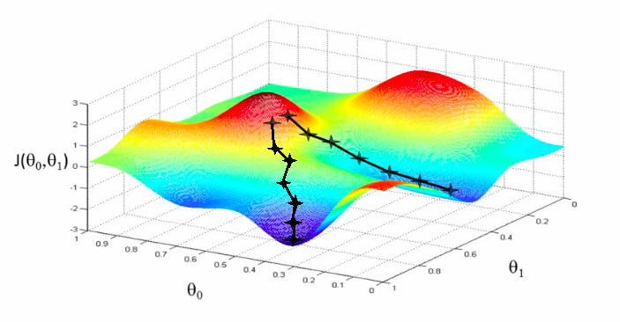
Deep Neural Network: Training
Update weights by gradient descent:
w₂
w₁

Slide 24
Backpropagation
Back-propagation: gradients are computed in the direction from output to input layers and combined using chain rule
CHAIN RULE:
If
Then
→ Derivatives can be computed by following well-defined procedures

Slide 25
The Training Loop
Repeat for multiple epochs
Get a batch of data
Forward pass: Calculate predictions
Calculate Loss
Backward pass: Calculate gradients (Backprop)
Update weights/biases (Optimizer)
We usually have a number of hyperparameters to tune
Optimizer hyperparameters like learning rate
Batch size
Epochs

Slide 26
Connection Architecture
Fully connected
Convolution
Recurrent
Self-attention

Slide 27
Fully connected layers
x₁
softmax
x₂
…
x₃
…
…
…
…
…
x_{L}

